Slide 1
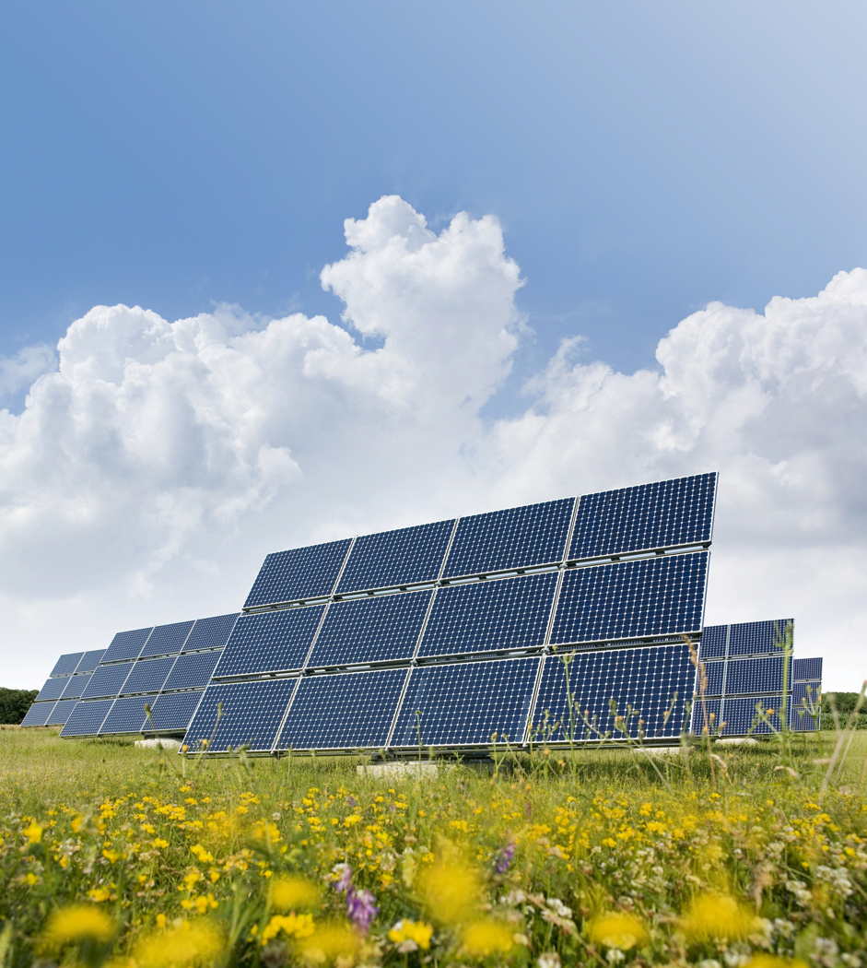
Solar Fields UK Investment Opportunities

Slide 2
Introduction
Property Fund Partners Ltd was established by Andrew Freeth to provide advice and support to clients wishing to set up Property Investment Funds either as Joint Ventures, closed or open, retail or institutional either in the UK or offshore.
Andrew has significant experience of the sector based on his previous roles at The Mansion Group where, as Director of Fund Development and Administration, he established two retail funds and five joint ventures. Andrew also advised on several Funds whilst at Grant Thornton and on several large portfolios at Andersen and Chesterton.
SolarFieldsUK.com and SolarFieldsUK.co.uk are owned by Andrew and set aside to support the establishment of a investment fund designed to invest in the Solar Energy sector in the UK and Renewable Energy Projects Ltd has been set up as an operating company for the project.
This presentation sets out the ambitions of Renewable Energy Projects Limited and the rationale for pursuing this sector.

Slide 3
Contents
MidAmerica Solar ( a Warren Buffet company) acquired a 579 Mw pair of solar projects from Sunpower in January 2013
Aims and Objectives
Background
Opportunity
Structure
Management Team
Operation
Benefits Analysis
Future Growth Strategy
The UK Renewable Energy Roadmap named Solar as the Key Technology in the UK’s quest to meet its binding environmental targets – Jan 2013

Slide 4
Aims & Objectives
Create the largest Solar Energy Fund in the UK
Across at least c. 1,000 acres of farm land in the UK
Install over 1,100,000 250kW Photovoltaic (PV) solar panels
Attract over £300m retail investment from UK & International IFA’s
Secure contract income for 20 years with annual uplifts
Deliver market comparable returns
Build a platform to diversify into other renewable energy sectors
Establish a business model that can be replicated in Europe as well as globally

Slide 5
Background
PV technology has improved significantly in recent years and systems are now much more affordable
A Feed In Tariff (FIT) system remains in place and is now much more supported by the UK Government. In October 2012, Greg Barker (Minister for Energy and Climate Change, said
  “I am fully committed to spurring on growth in clean green energy generation across the UK and want to provide long term certainty for those who choose to invest”
Warren Buffet (a world renowned investor) has just acquired 579 MW Solar Park from SunPower in the US suggesting that the sector is becoming much more established as a recognised investment opportunity
There is also now a greater acceptance of the ability of the UK to generate electricity from PV panels – currently we generate 1.8GW from Solar and are approaching the 2.0GW milestone
Government backed figures support return of 10-12% in most UK locations suggesting this is a conservative target

Slide 6
Opportunity
There are very few significant Solar Farms as yet in the UK
Households are beginning to support the idea of PV panels at home which is increasing the market for panels and therefore costs are falling
There are 300,000 farms across the UK who look after 42.25 million acres of the UK. They constantly face economic challenges and are expected to welcome the proposed income stream from a Solar Field (NB - the fund will cover only 0.002% of this land mass)
The proposed Solar Fields will occupy no more than two acres of land, will be less than 4m high and unobtrusive, screened from view and environmentally friendly in terms of installation (i.e. no significant foundations required)

Slide 7
Opportunity (2)
UK Planning system already supports PV panel installations and local Authorities are encouraged to support Green Energy projects in the National Planning Policy Framework (NPPF) published in 2012.
“when located in the Green Belt, elements of many renewable energy projects will comprise inappropriate development. In such cases developers will need to demonstrate very special circumstances if projects are to proceed. Such very special circumstances may include the wider environmental benefits associated with increased production of energy from renewable sources”
- clause 91, page 21 NPPF
FIT contracts will be for 20 years with annual inflation increases in tariff
The Government want to see 20 GW generated from Solar Energy by 2020, a 10 fold increase!
“Solar is now on a firm footing to build deployment and a ‘go to’ solution for energy generation” – Greg Barker (Minister for Energy and Climate Change) statement at the opening of the National Solar Centre in Jan 2013

Slide 8
Structure
An Offshore and Onshore structure will be developed to meet the requirements of a range of investors
The Onshore vehicle will seek to maximise returns utilising the current capital allowances available in the sector and repay initial investment within 2 years and an ongoing return thereafter, tax free, for a further 18 years.
The Offshore vehicle will target smaller portfolios of sites and therefore levels of equity investment and offer a shorter investment horizon of c. 4 years

Slide 9
Management Team
EXECUTIVE BOARD
Site Procurement
Project Management
Investment & Administration
Barry Thorogood
Alan McCarthy
Andrew Freeth
Jenny Brady
Land Agents
Planning & Development Consultants
Feasibility & Technical Implementation
Contractor Liaison
IFA Networks & Agents
Marketing
Investor Liaison
Finance
Admin & CRM
IT &Website

Slide 10
Modus Operandi – 3 month cycle
Farmers Approached
Field Sites Identified
Sites Surveys
Feasibility Assessment
Technical Drawings
Options Secured
Planning Permission Granted by LA
Planning Application
8 Weeks
Legal Docs
Grid Connection
Negotiations
FIT Contact Agreed
Lease Agreed
IFA Network Approached
Applications Processed
All Agreements Signed
Cash Received
Contracts Placed

Slide 11
Operation (2)
Four installation types – 0.75 acre increments up to 1.234 acres (poss 2 acres in exceptional cases)
4 sites per month rising to target of average of 22 per month by month 7
Target 1250 sites, c. 1,000 acres, c. 1,100,000 250kW panels
Average Installation costs c. £1.15 per watt including all professional fees, installation and connection costs
Regional Targets
  30% South Coast
  25% South
  20% Midlands
  20% North
  5% Scotland

Slide 12
Operation (3)
Land occupied under 25 year Lease agreements or 40 years if appropriate
Rental Payment either by way of annual rent, percentage of income or installation of panels for the Farms use
Panels fixed in due south position at 30-40 degrees with inverters providing remote monitoring of panel performance
Panels set in rows 3-4 meters apart and no more than 4m high with minimal foundations
All sites bounded by secure fence and landscaping and fully insured against theft, malicious damage and public liability
Sites maintained by farmers and monitored remotely and inspected periodically

Slide 13
Operation (4)
Standard Feasibility assessment model utilised across the UK via network of Project Managers
Standard and centralised Planning process employed for each site
Standard documents used to agree Leases with Farmers and Energy Companies
Competitively priced installation contracts agreed with limited number of reputable regional contractors on Framework Agreements
Purchasing power utilised to manage cost of PV panels via direct relationships with manufacturers
Standard IFA Agent contracts

Slide 14
Benefits Analysis
20 year contract income
Strong income covenant
Income inflation proof
Modular implementation
Short implementation phase
Ease of Management
Low investment requirements
Improving technology
Reducing costs
Limited competition
Large target market for sites
Strong Investor returns
Ease of replication and diversification
Government support
Benefits
Planning Permission restrictions
Mechanical Failure
Theft of Equipment
Grid access costs or delays
Limited current investment market
Government policy change
Potential Fund Redemptions
Limited number of Fund Administrators and partners
Risks

Slide 15
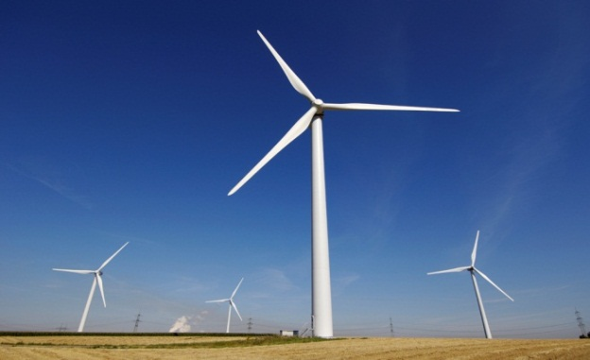
Future Growth Strategy
Build a base portfolio of c. £300m assets, and to grow assets to c £750m by year 10
Utilise existing relationships with landlords (farmers) to establish a Wind Turbine and a BioMass Investment Opportunities
Create template of Fund operation to replicate in other global markets
Attract Institutional interest in SolarFieldsUK Limited within 5 years to secure capital to fund diversification and expansion into new markets
Develop capability to sell generated
electricity to farmers and increase income
and exceed the current business plan

Slide 16

Appendices
Biographies of Team
Press Articles
Feed In Tariff schedule
References

Slide 17
Andrew Freeth
Qualified Chartered Surveyor with over 20 years of real estate experience across the UK
BSc Hons degree in Land Management
Past Chairman of the RICS Management Consultancy Faculty and regional Chairman of the RICS Junior branch in Manchester
Worked for Chesterton (‘91-’98), Arthur Andersen (‘98-’02), Grant Thornton (‘02-’08) and The Mansion Group (‘08-’12)
Responsible for the development and administration of two retail funds, 4 institutional joint ventures and 2 private placement funds
Co-responsibility for the set up of a Property Alternative Investment Fund (PAIF) – one of only 5 trading in the UK – in the Student Accommodation sector
Strong modelling skills, creative & logical thinker and positive attitude
Married, two children, two dogs, hobbies include swimming, walking, cycling, snooker, bowling, cinema, car racing and MUFC
Based in Woodford, Stockport and previous Chairman of the Woodford War Memorial Community Centre

Slide 18
Barry Thorogood
Management Consultant focused on Leadership, Team Building and Organisational Change
Qualified teacher with MA in Management Learning
Founder of Team International which was established in 1990 and now works with companies such as Bombardier
Post his role as Deputy Head of a London school for maladjusted children, Barry took on a role as Regional Manager of Sales for Xerox
At Xerox, Barry’s team achieved 439% of their target and he has now written & published the first of a series of Sales training books, “Pencils and Battleships”
Strong track record in exceeding expectations and delivering successful change programmes
Visionary ideas, realist, open and honest mentor with a good sense of humour
Two children, 4 grandchildren, two dogs, hobbies include flying, property renovation, swimming, walking, canoeing, sailing and Buddhism
Based on the North Wales coast and consultant to Freshfields Animal Rescue which he has helped triple in size. Freshfields now rehomes 2,000 animals a year!

Slide 19
Alan McCarthy
Experienced Sales Consultant in Solar PV with over £1,000,000 of domestic sales
CeMAP Qualified Renewable Energy Surveyor
Rose from sales trainee to regional manager for J F Marsh Estate Agents
Set up own Textile Business and grew significant business with trade partners in the US, Japan and Europe
Contractor to Ministry of Defence responsible for more than £7m in sales and set up a new textile recycling company in Germany and France
Strong project and people manager, adept in change management programming and implementation as well as team motivation
Transparent thinker, reliable and honest team player
Married, 2 children, 2 grandchildren, dog, hobbies include flying, property renovation, swimming, walking and Beach combing.
Based on North Wales coast and provided long term care for his wife who has suffered from MS for the last 15 years

Slide 20

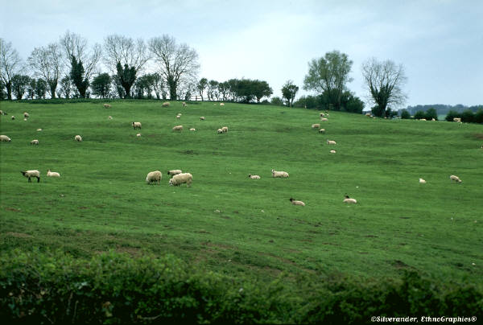
Questions ?

